Slide 1
Analysis of Defense Products Contract Trends, 1990-2014
Principal Investigator: Andrew Hunter
Researchers: Jesse Ellman and Gregory Sanders
May 14, 2015
Defense-Industrial Initiatives Group
Center for Strategic & International Studies
202-775-3183
www.csis.org/diig

Slide 2
Methodology
This slide describes the overall methodology employed to develop this dataset. Aggregated data downloads from FPDS are unavailable for pre-2000 data, requiring a different approach.
The Federal Procurement Data System (FPDS) was the primary source for this electronic data summary for 2000-2013. For 1990-1999, data from the legacy DD350 contract information system was used.
Federal regulations require only that all unclassified prime contracts worth $3,000 and above be reported to FPDS, although this level has varied during the study period.
FPDS data are constantly being updated, including those for back years. As a consequence, the dollar totals for a given year may have changed since the data was downloaded.
Contract classifications sometimes differ between FPDS and individual companies, resulting in contracts that a company considers as services being labeled as products by FPDS and vice versa.
Overseas Contingency Operations funding and other supplemental appropriations are not separately classified in FPDS.
All dollar figures are in constant 2014 dollars.

Slide 3
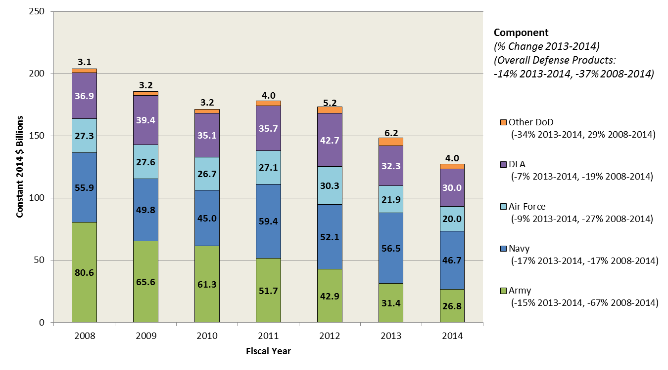
Defense Products Contract Obligations by Component, 2008-2014

Slide 4
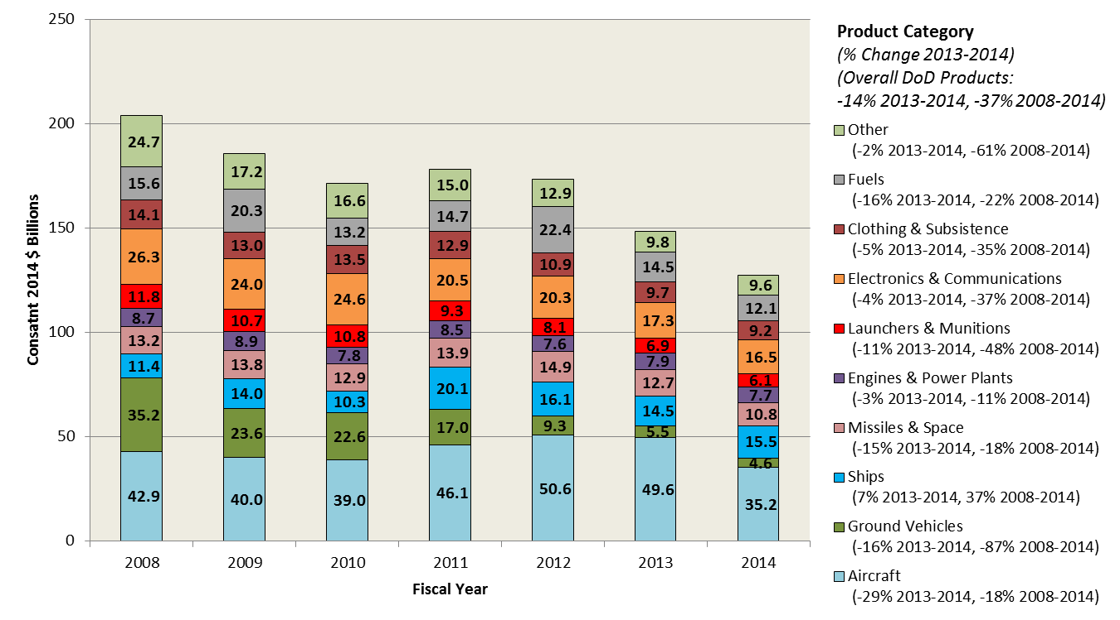
Defense Products Contract Obligations by Product Category, 2008-2014

Slide 5
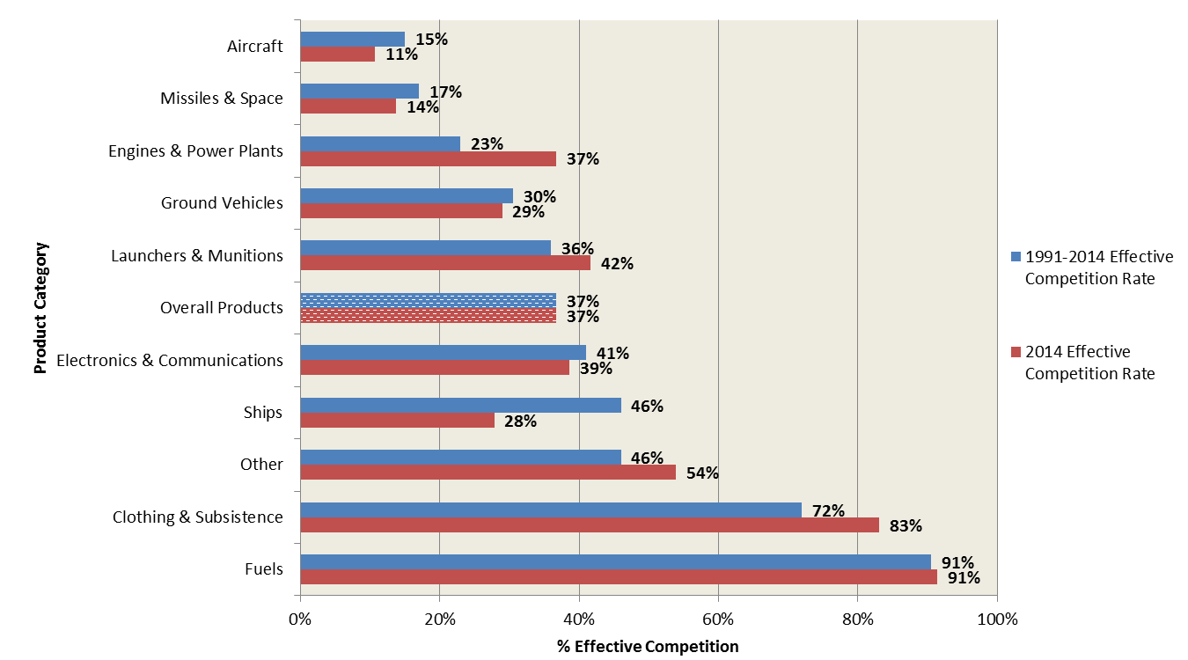
Rate of Effective Competition for Defense Products by Product Category, 2014 vs. 1991-2014

Slide 6
Notable Data Limitations Pre-2000
DD350 data for FY1990-FY1999 reflect pre-FY2004 reporting thresholds, which did not require DoD to report more than summary information on contracts below $25,000.
FY1990 has a significant percentage of data left blank or otherwise unclassifiable, mostly in the fields used for competition, pricing mechanism, and vehicle.
Prior to FY1997, DD350 data did not reliably differentiate between numbers of offers greater than 2 (such that most contracts receiving 2 or more offers had “2” listed as under number of offers.) As such, pre-1997 competition data has reduced granularity in terms of number of offers.
CSIS had intended to use pre-2000 data from the FPDS webtool (https://www.fpds.gov/fpdsng_cms/index.php/en/) for validation of the DD350 data. In the course of investigation, however, CSIS discovered significant contracting activity from FY1990-FY1995 missing from FPDS, on the order of $20 billion/year (in then-year dollars).
Upon further investigation, CSIS discovered that these missing obligations are a mix of contracts entirely missing from FPDS and contracts missing a significant percentage of their value in a given year (with the difference not shifted to surrounding years).
CSIS consulted with DoD officials to determine the sources of this data inconsistency. Some of the discrepancy may be related to data for certain types of contracts (like Foreign Military Sales) not being transferred into FPDS when that system was stood up. In addition DD350 data was frozen after validation and FPDS

Slide 7
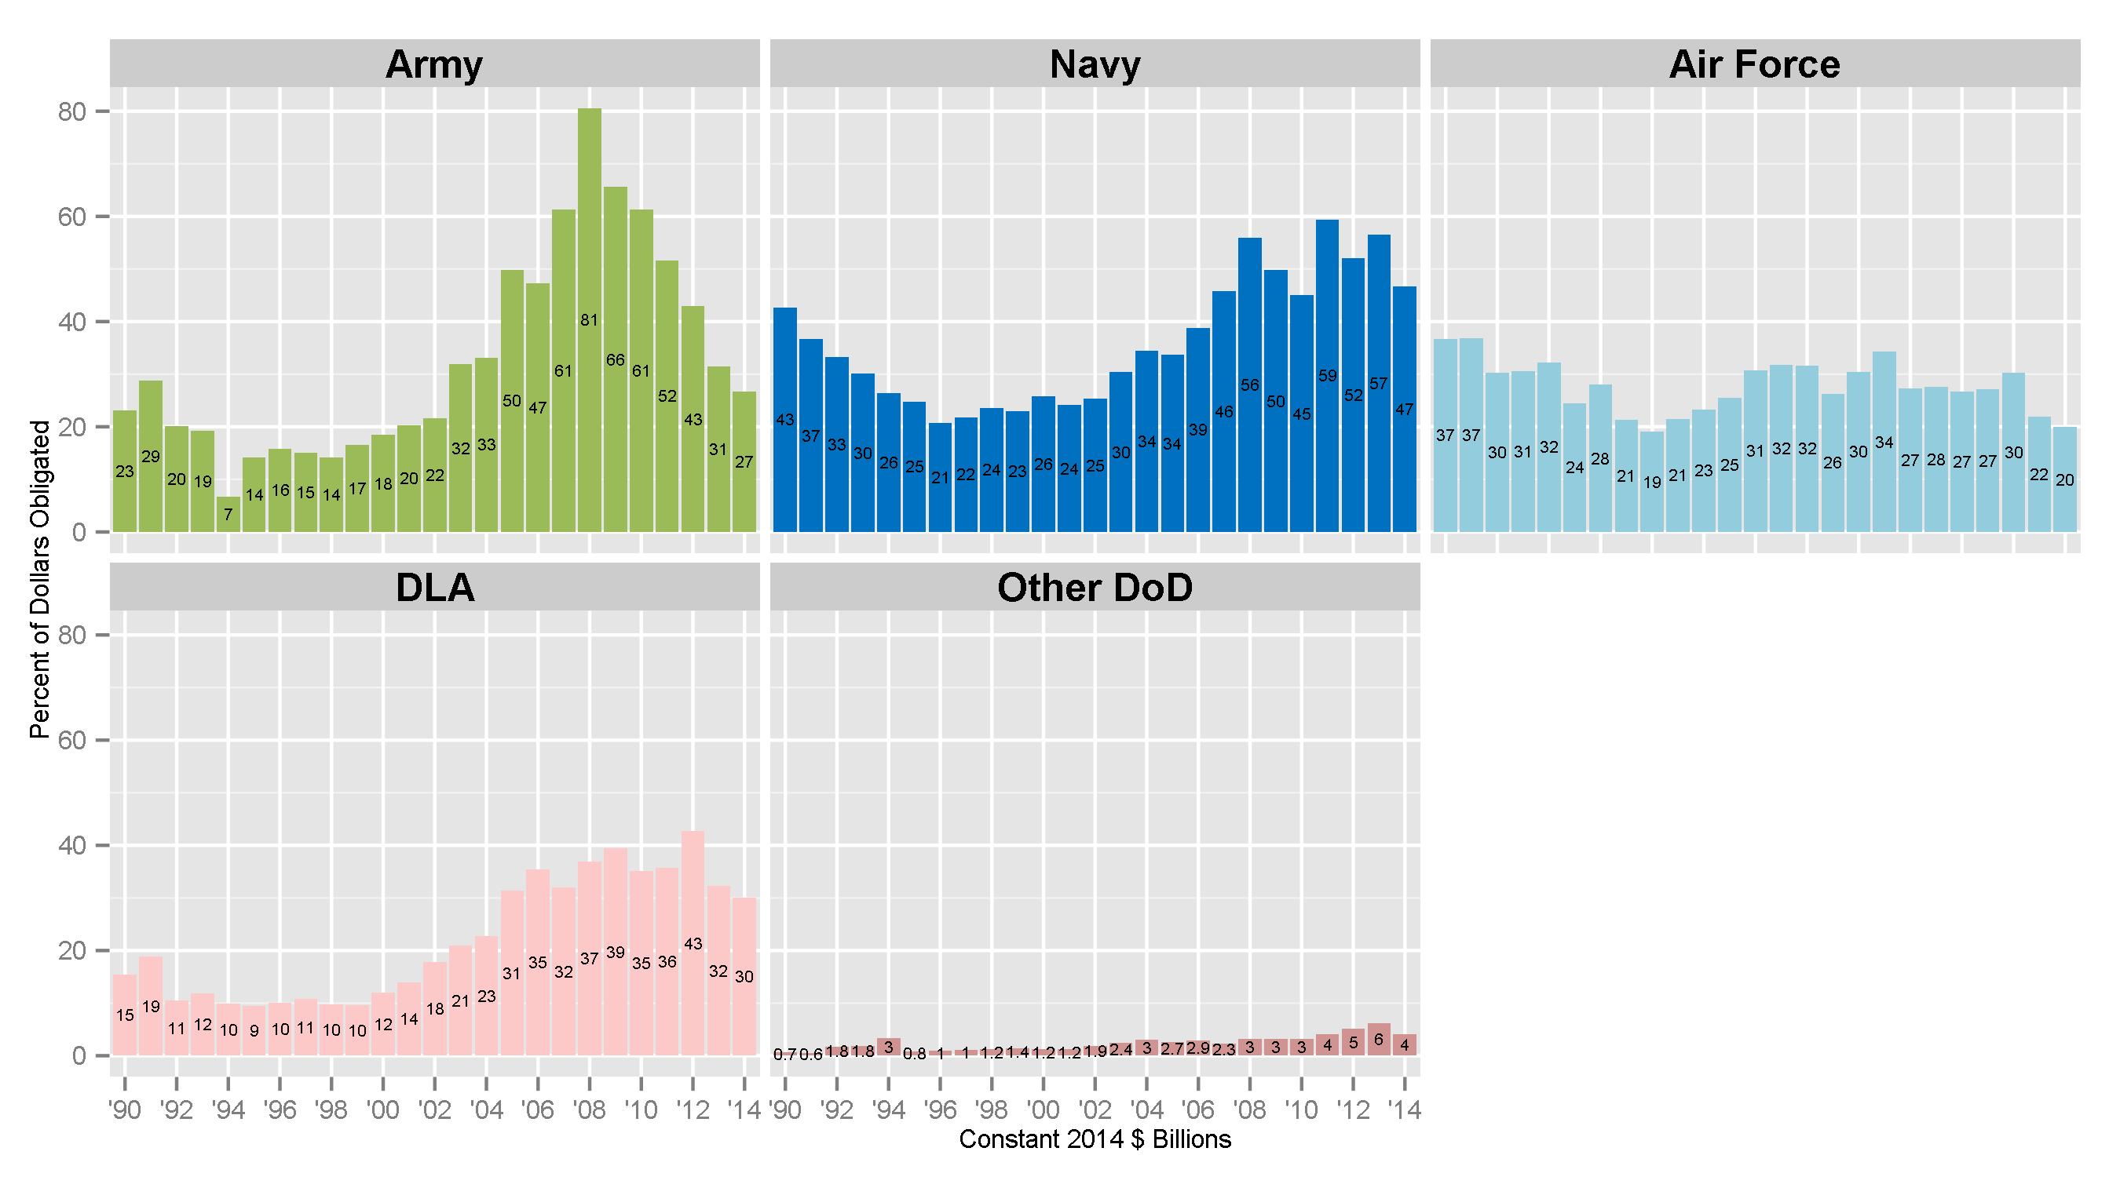
Defense Products Contract Obligations by Component, 1990-2014

Slide 8
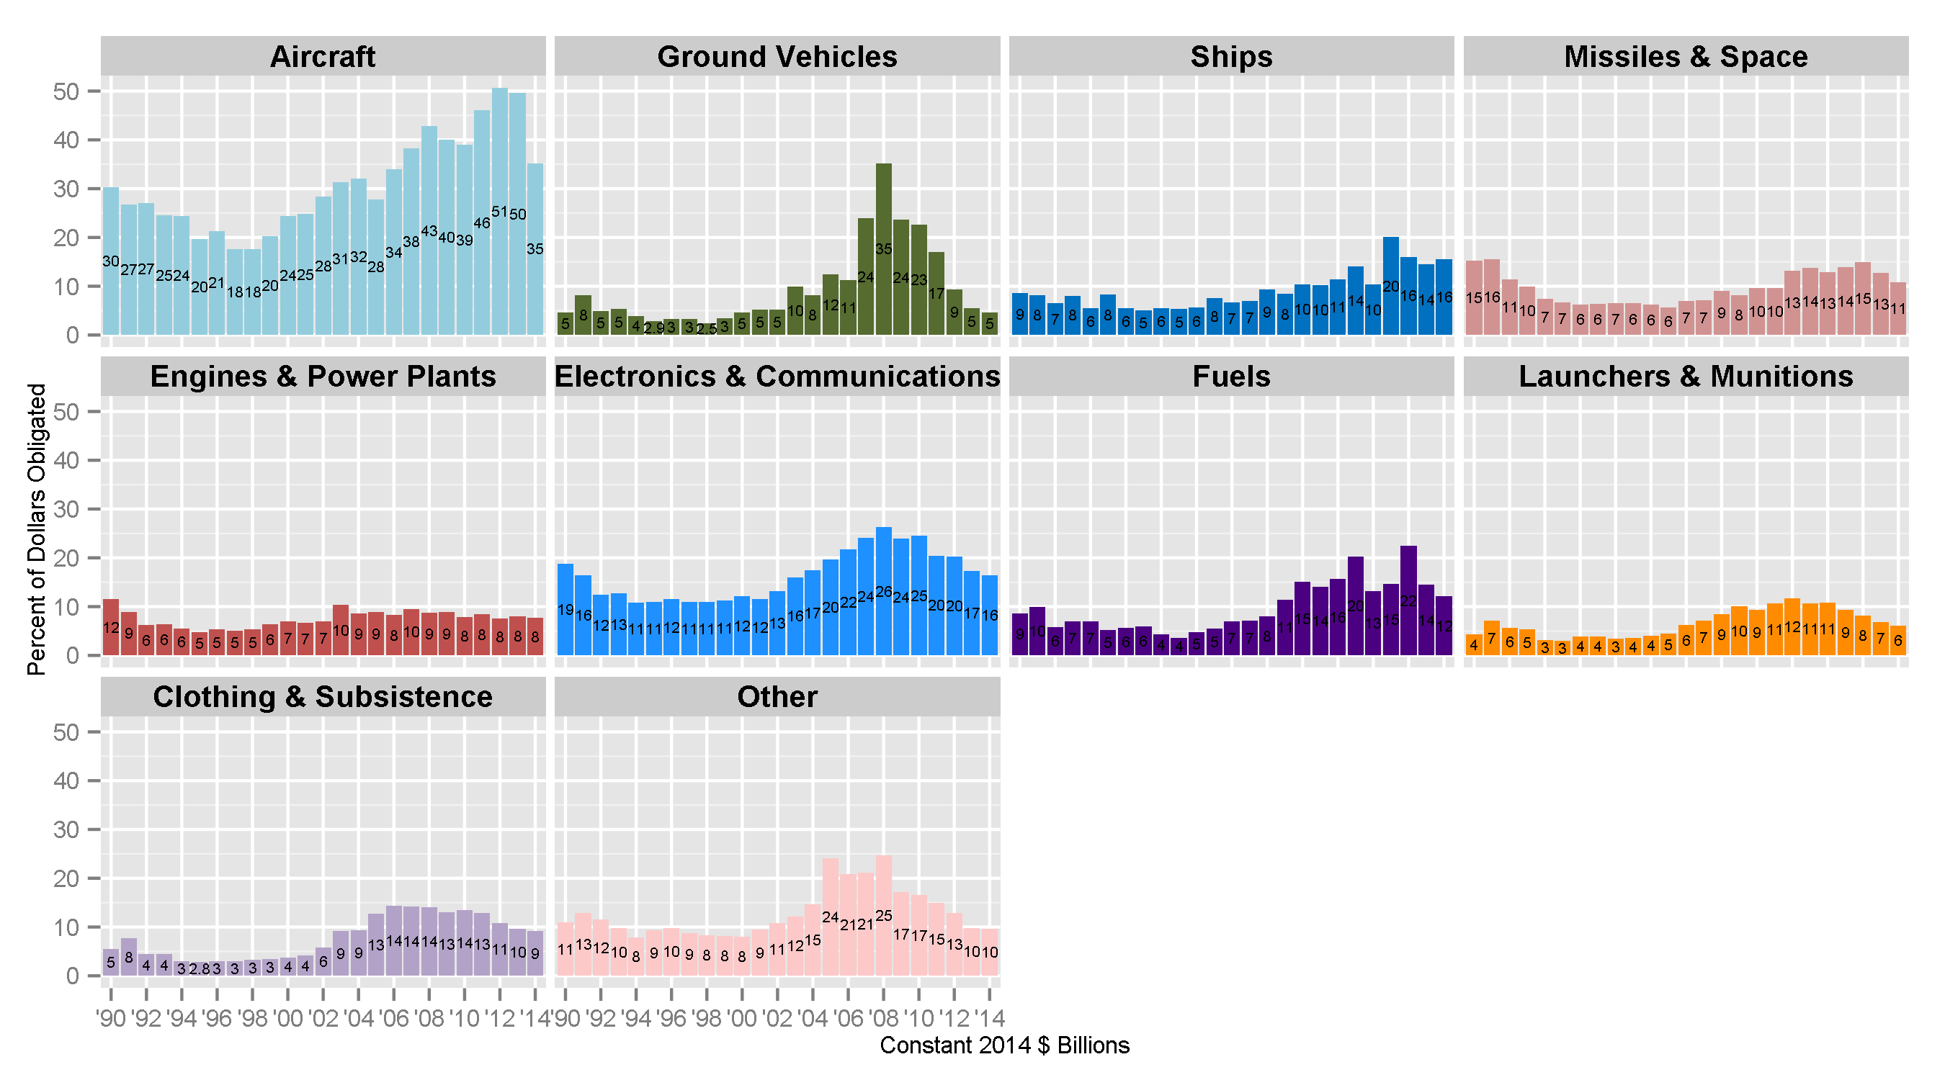
Defense Products Contract Obligations by Product Category, 1990-2014

Slide 9
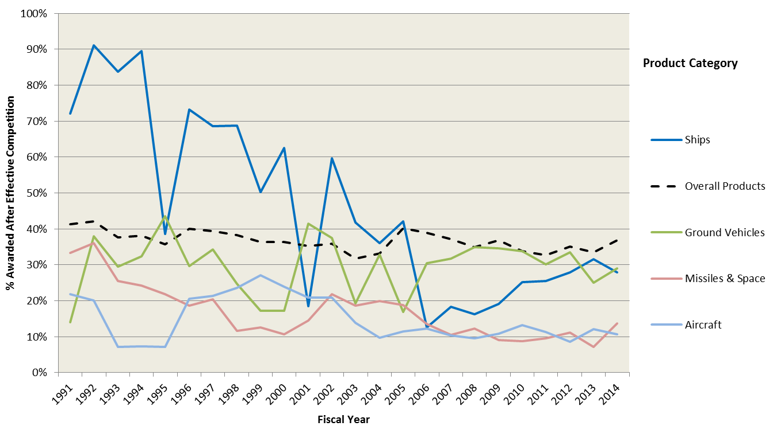
Rate of Effective Competition for Defense Products by Product Category, 1991-2014 (I of III)

Slide 10
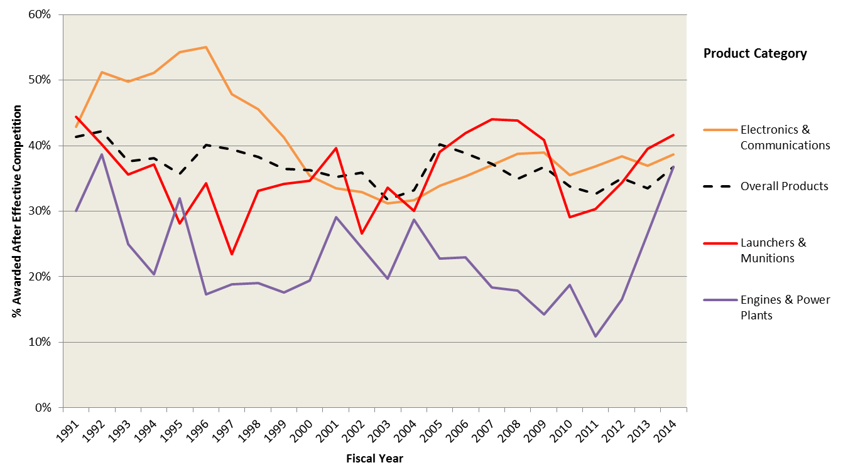
Rate of Effective Competition for Defense Products by Product Category, 1991-2014 (II of III)

Slide 11
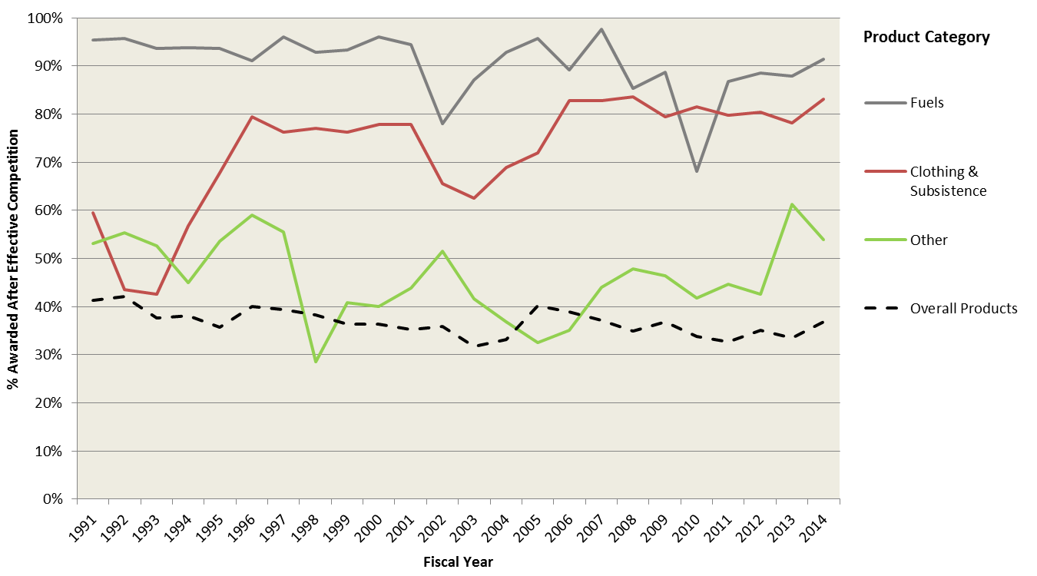
Rate of Effective Competition for Defense Products by Product Category, 1991-2014 (III of III)

Slide 12
Definition of the Big 6 pre-Last Supper
We keep our Big 6 classifications consistent based on current top companies:
Lockheed Martin (or Lockheed)
Boeing
Northrop Grumman
Raytheon
United Technologies
This excludes Martin Marietta and McDonnell Douglas.

Slide 13
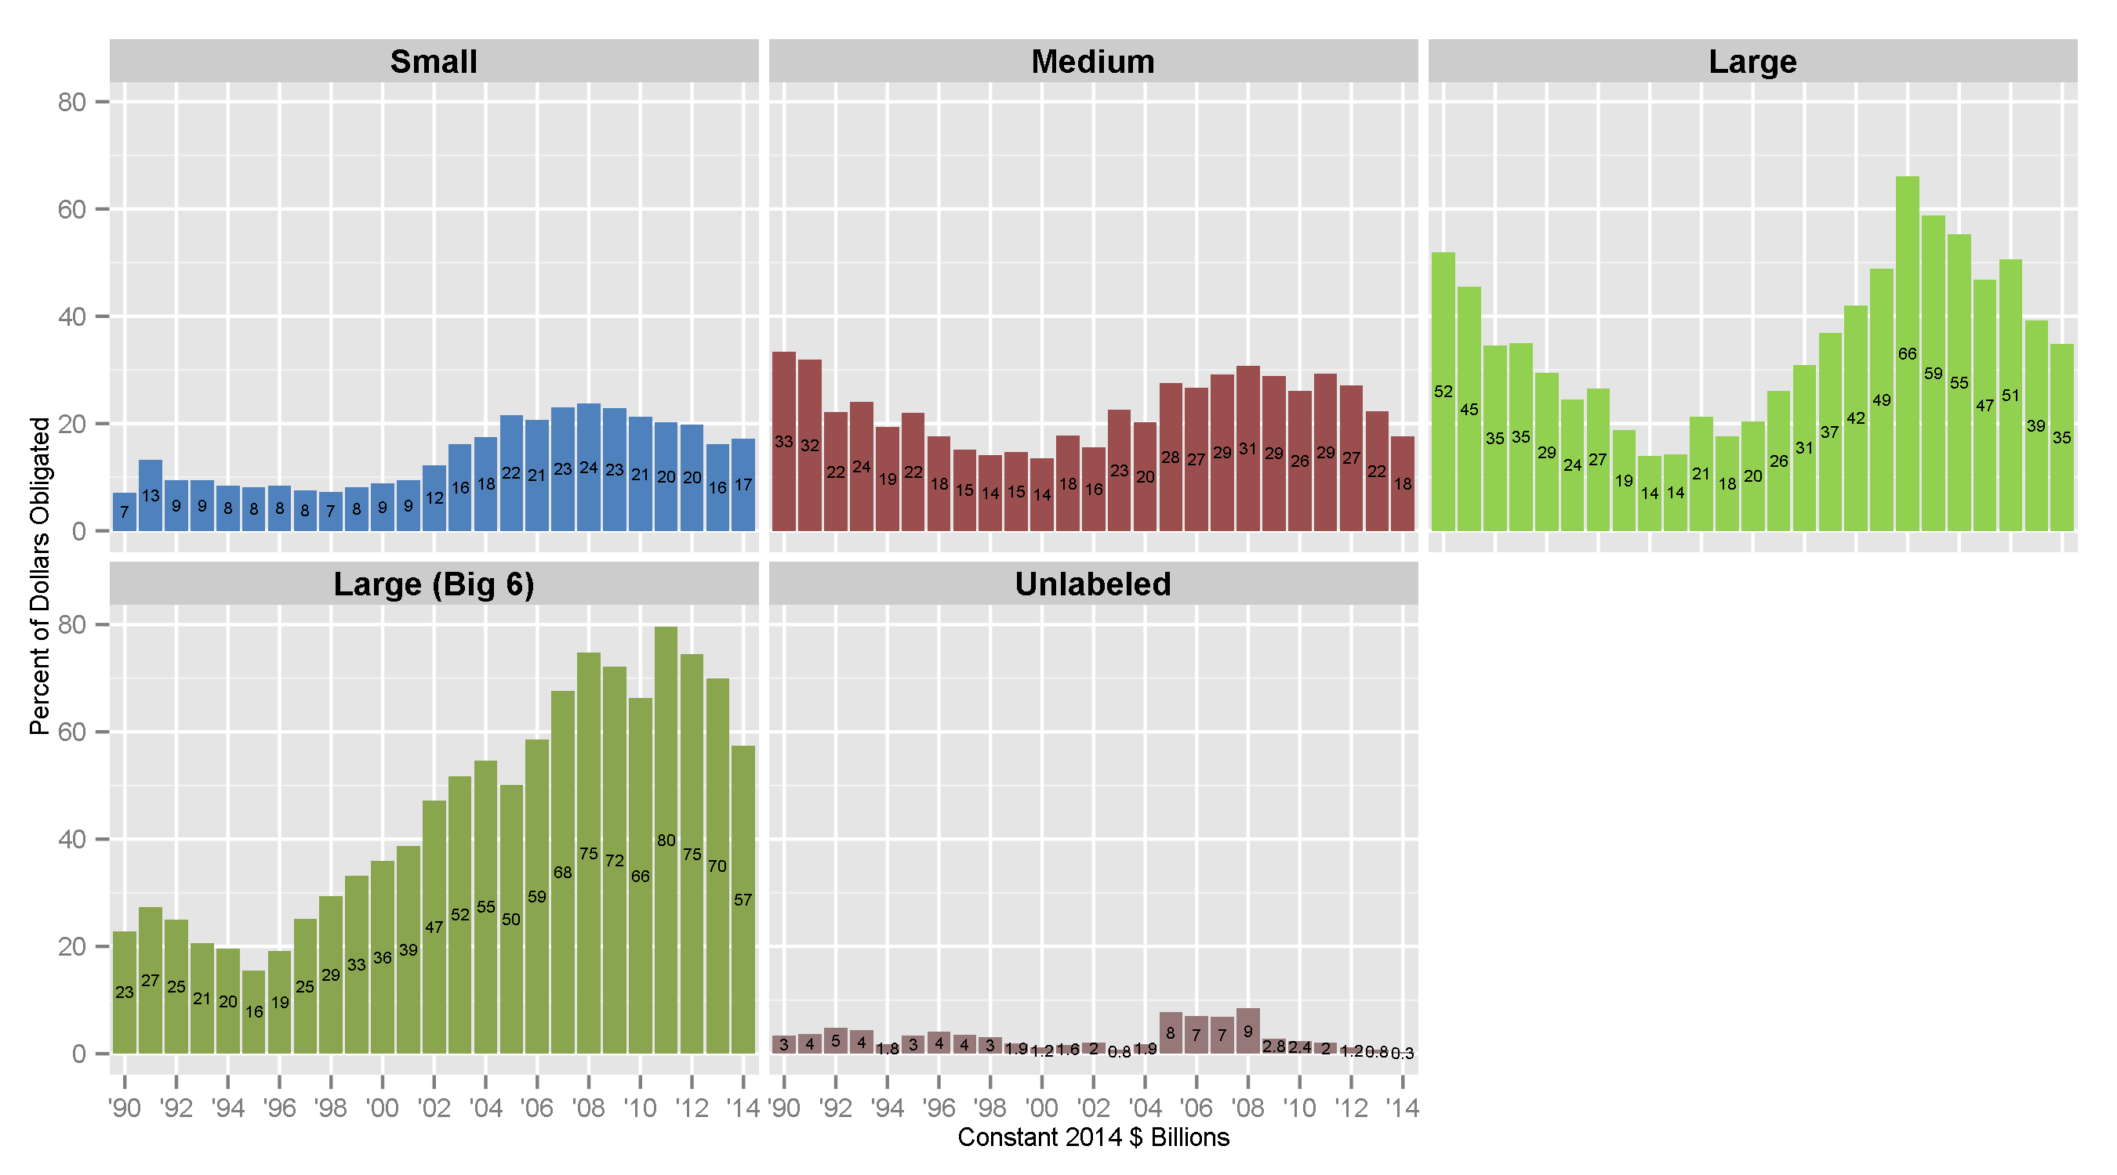
Defense Products Contract Obligations by Vendor Size, 1990-2014

Slide 14
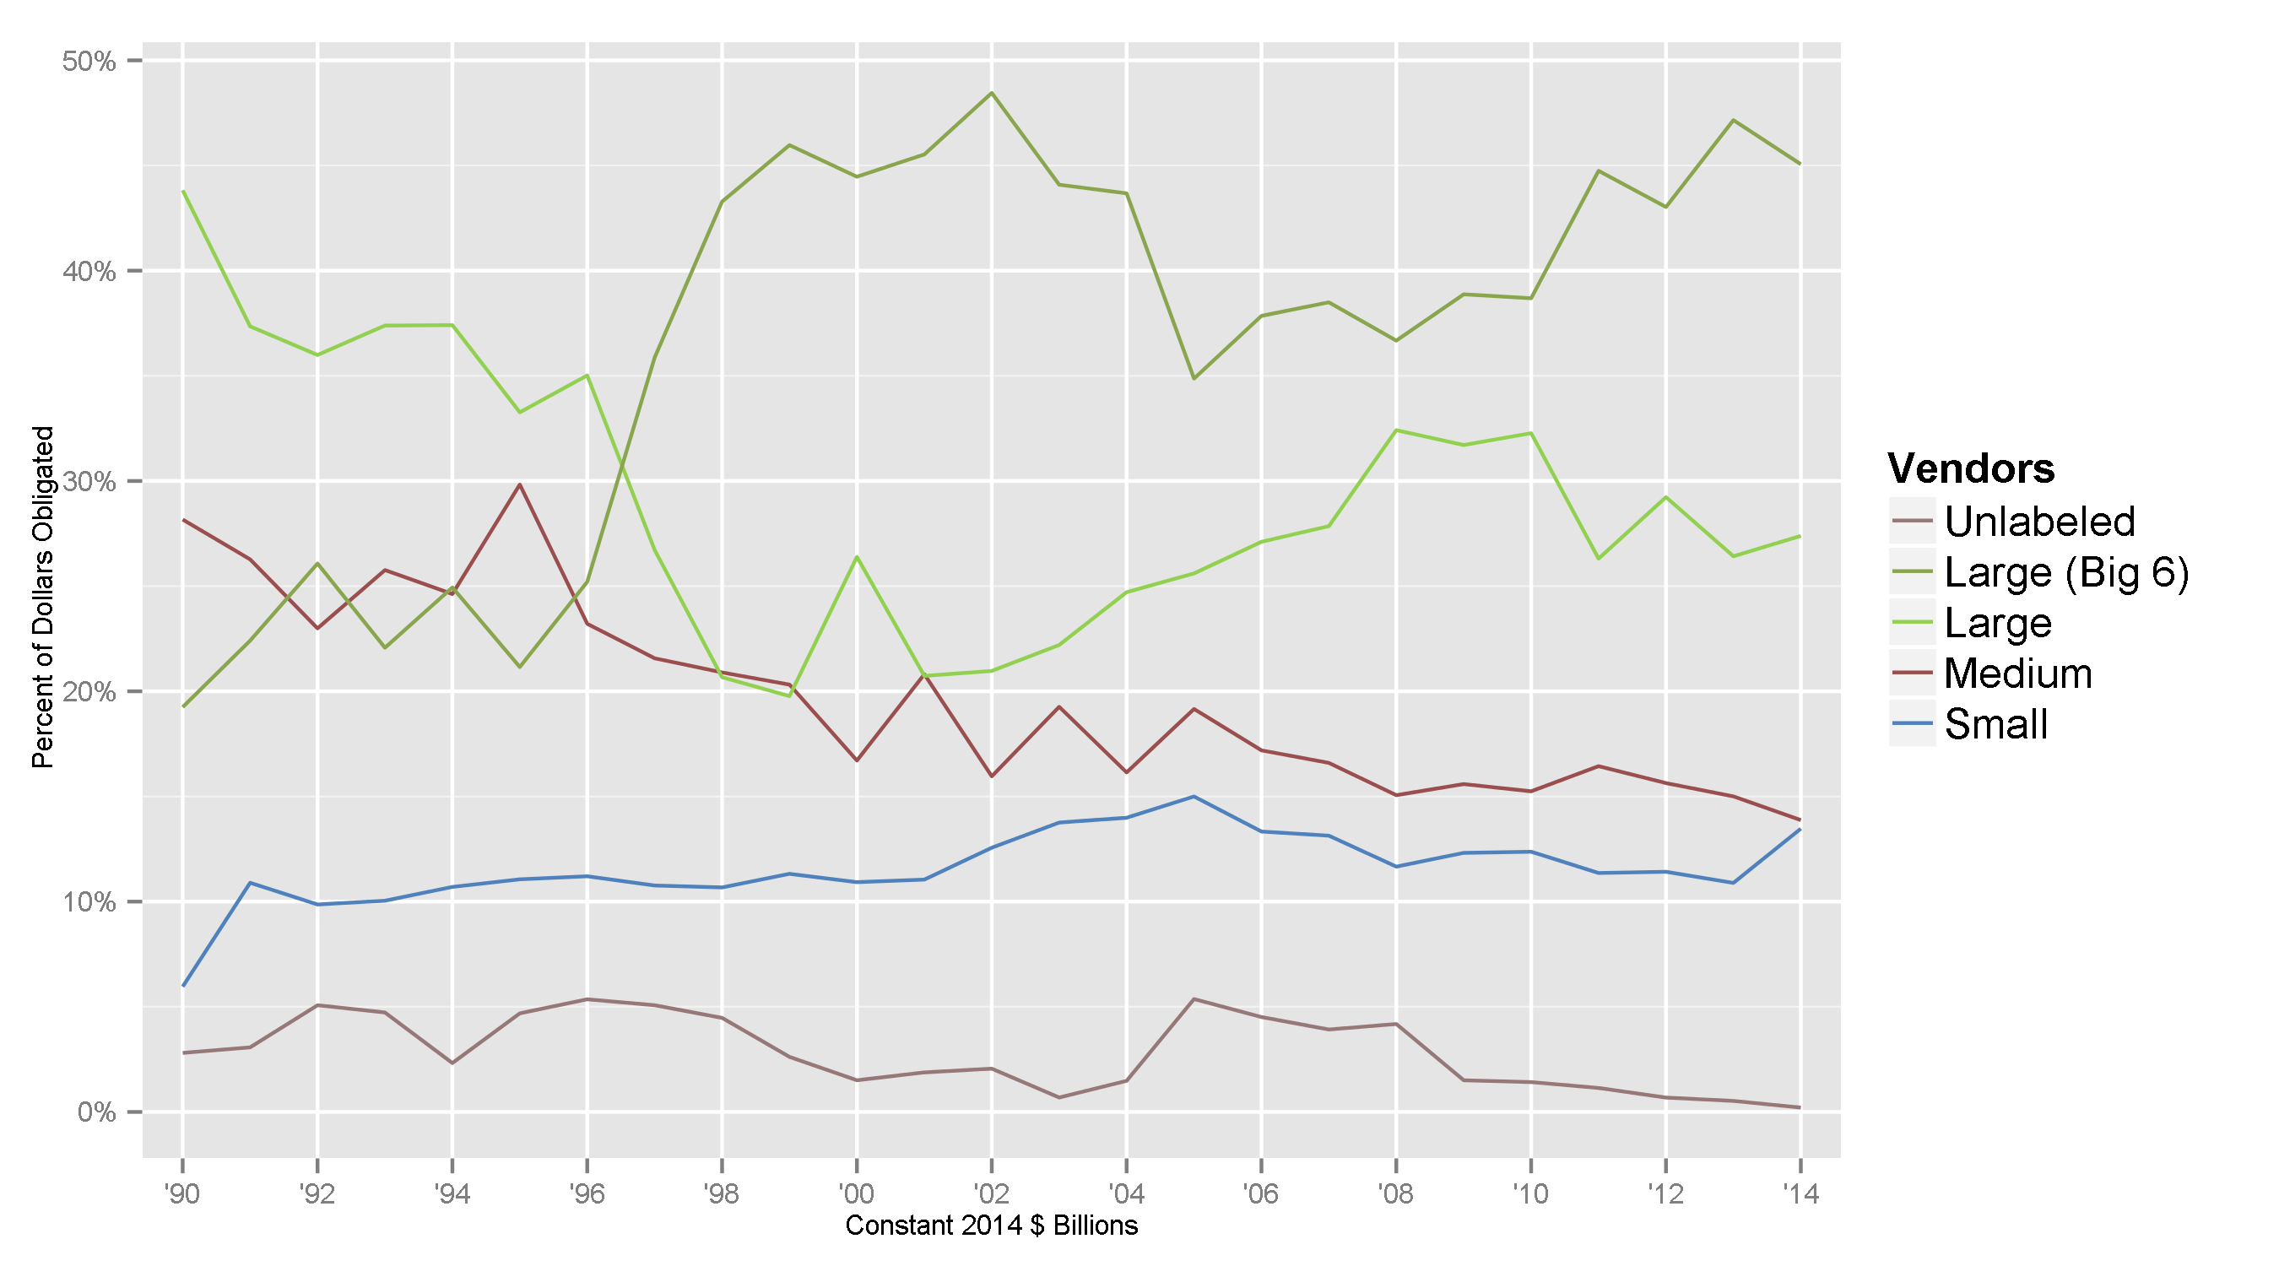
Defense Products Contract Obligations by Vendor Size, 1990-2014

Slide 15
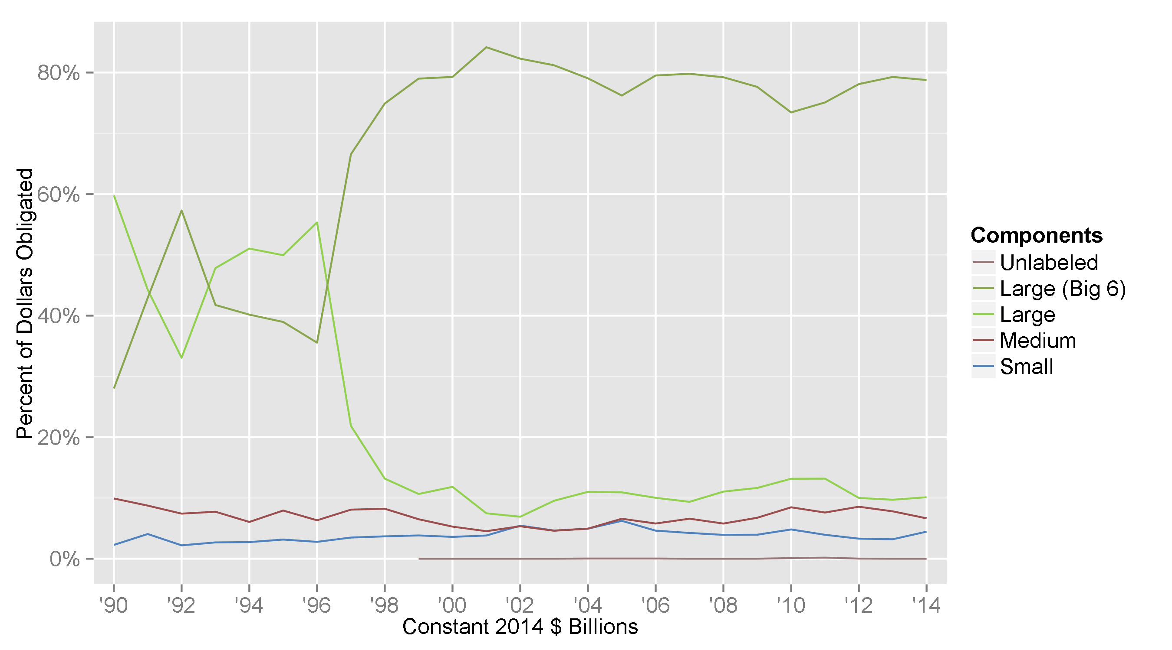
Defense Aircraft Contract Obligations by Vendor Size, 1990-2014

Slide 16
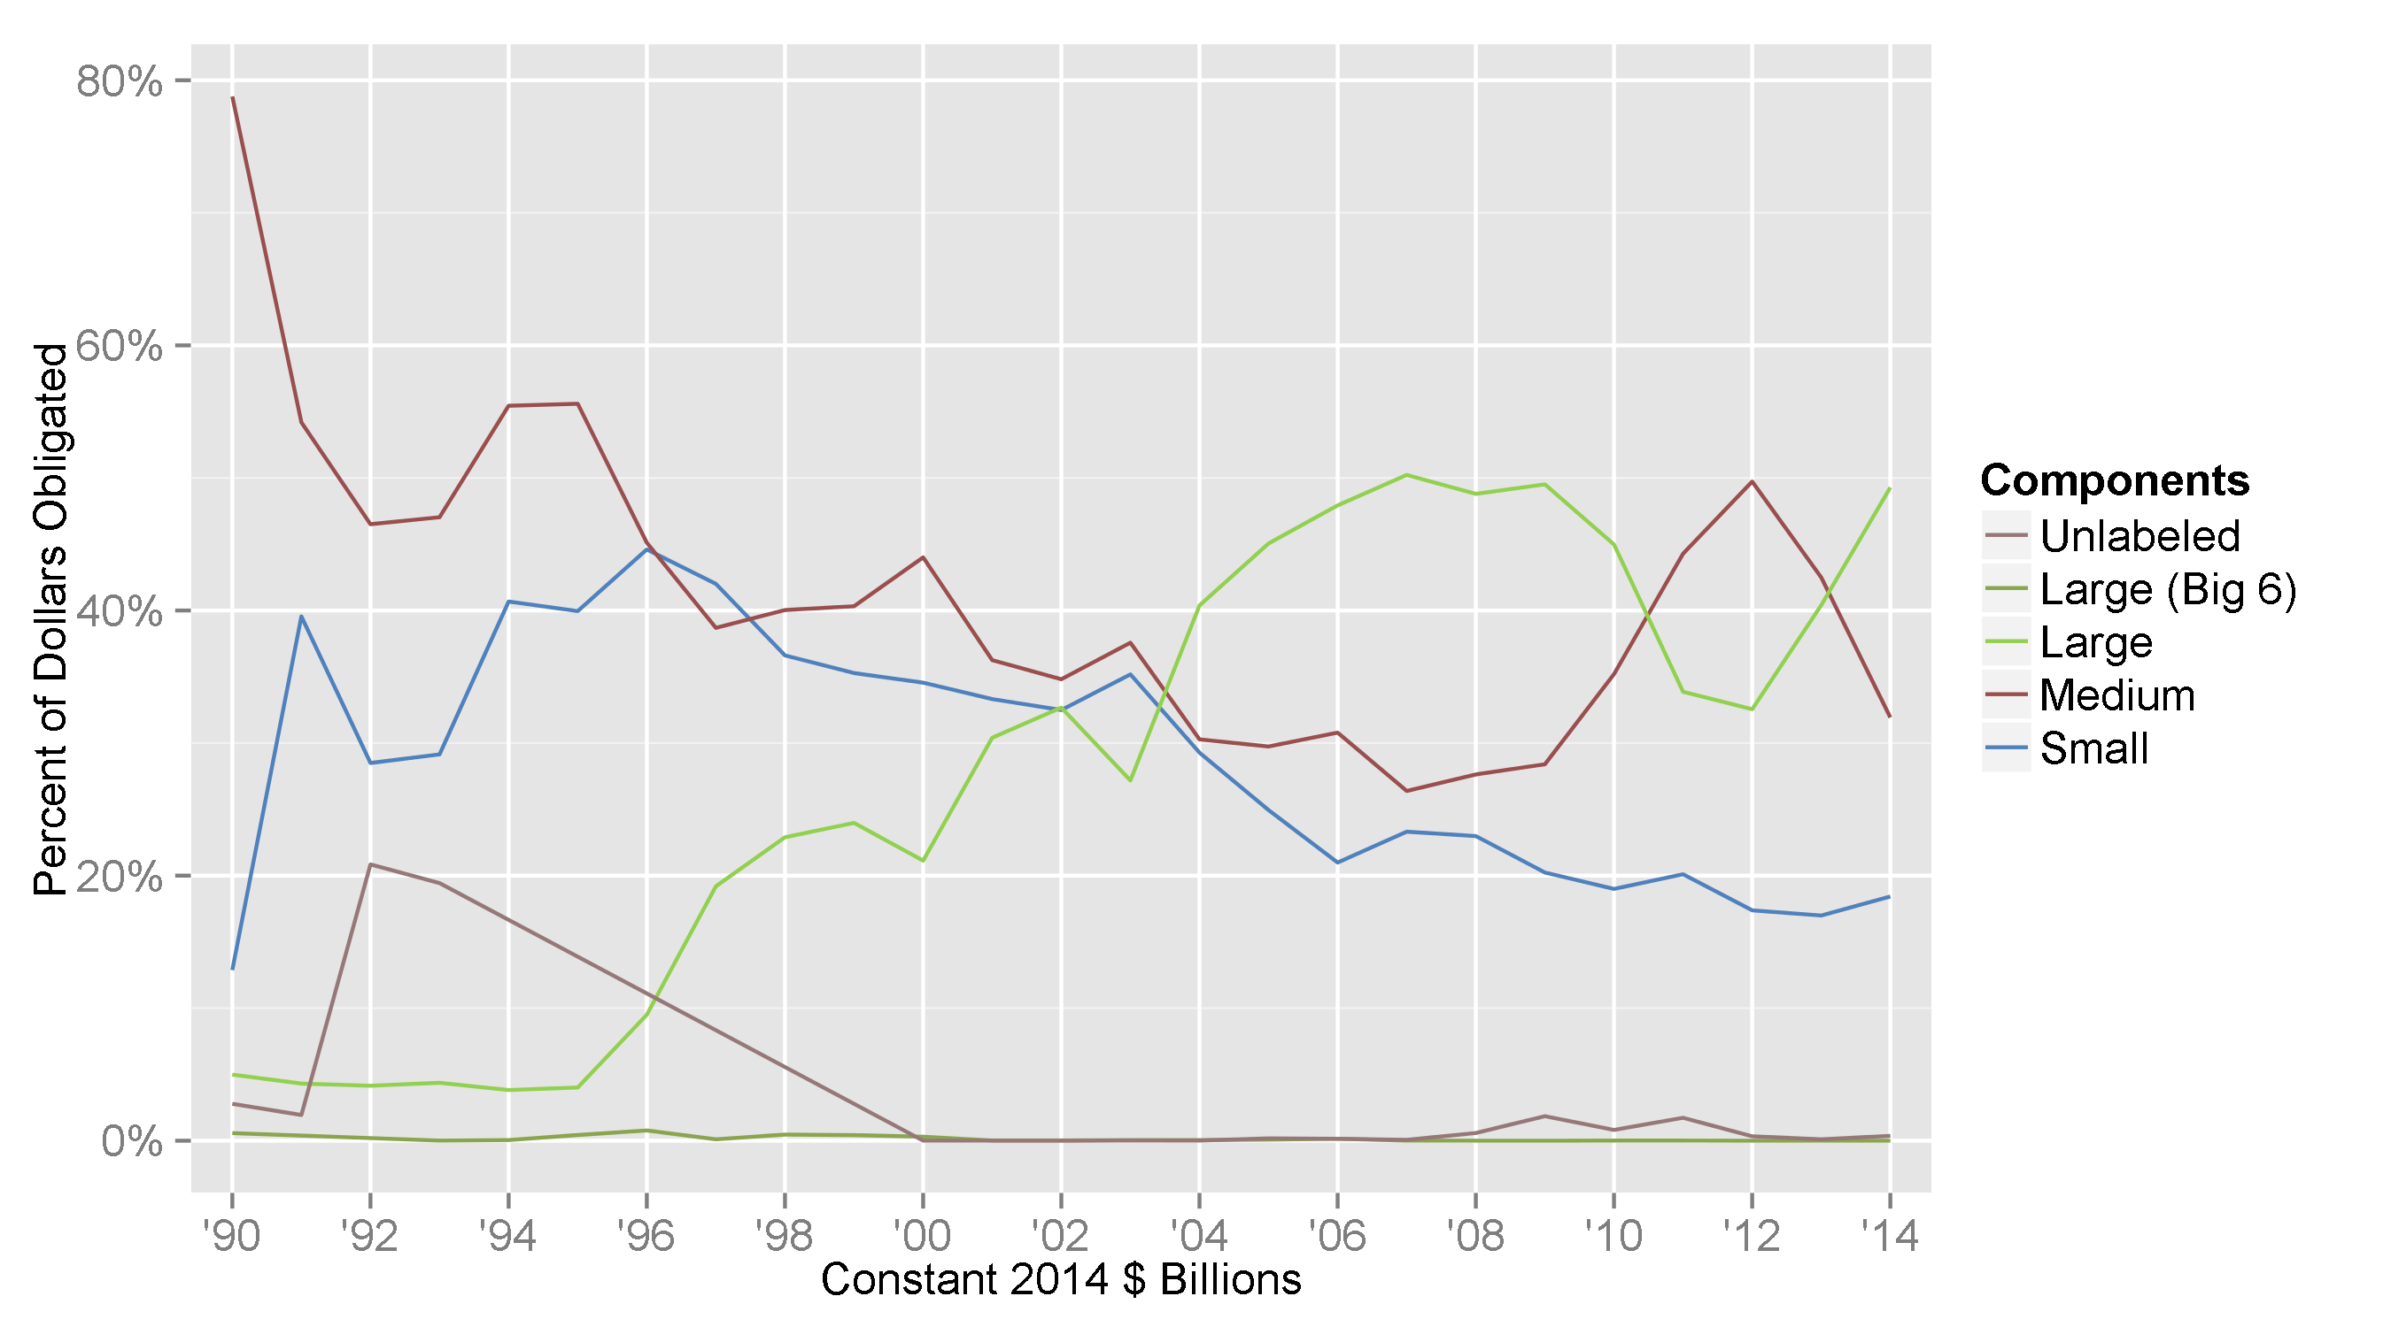
Defense Clothing & Subsistence Contract Obligations by Vendor Size, 1990-2014

Slide 17
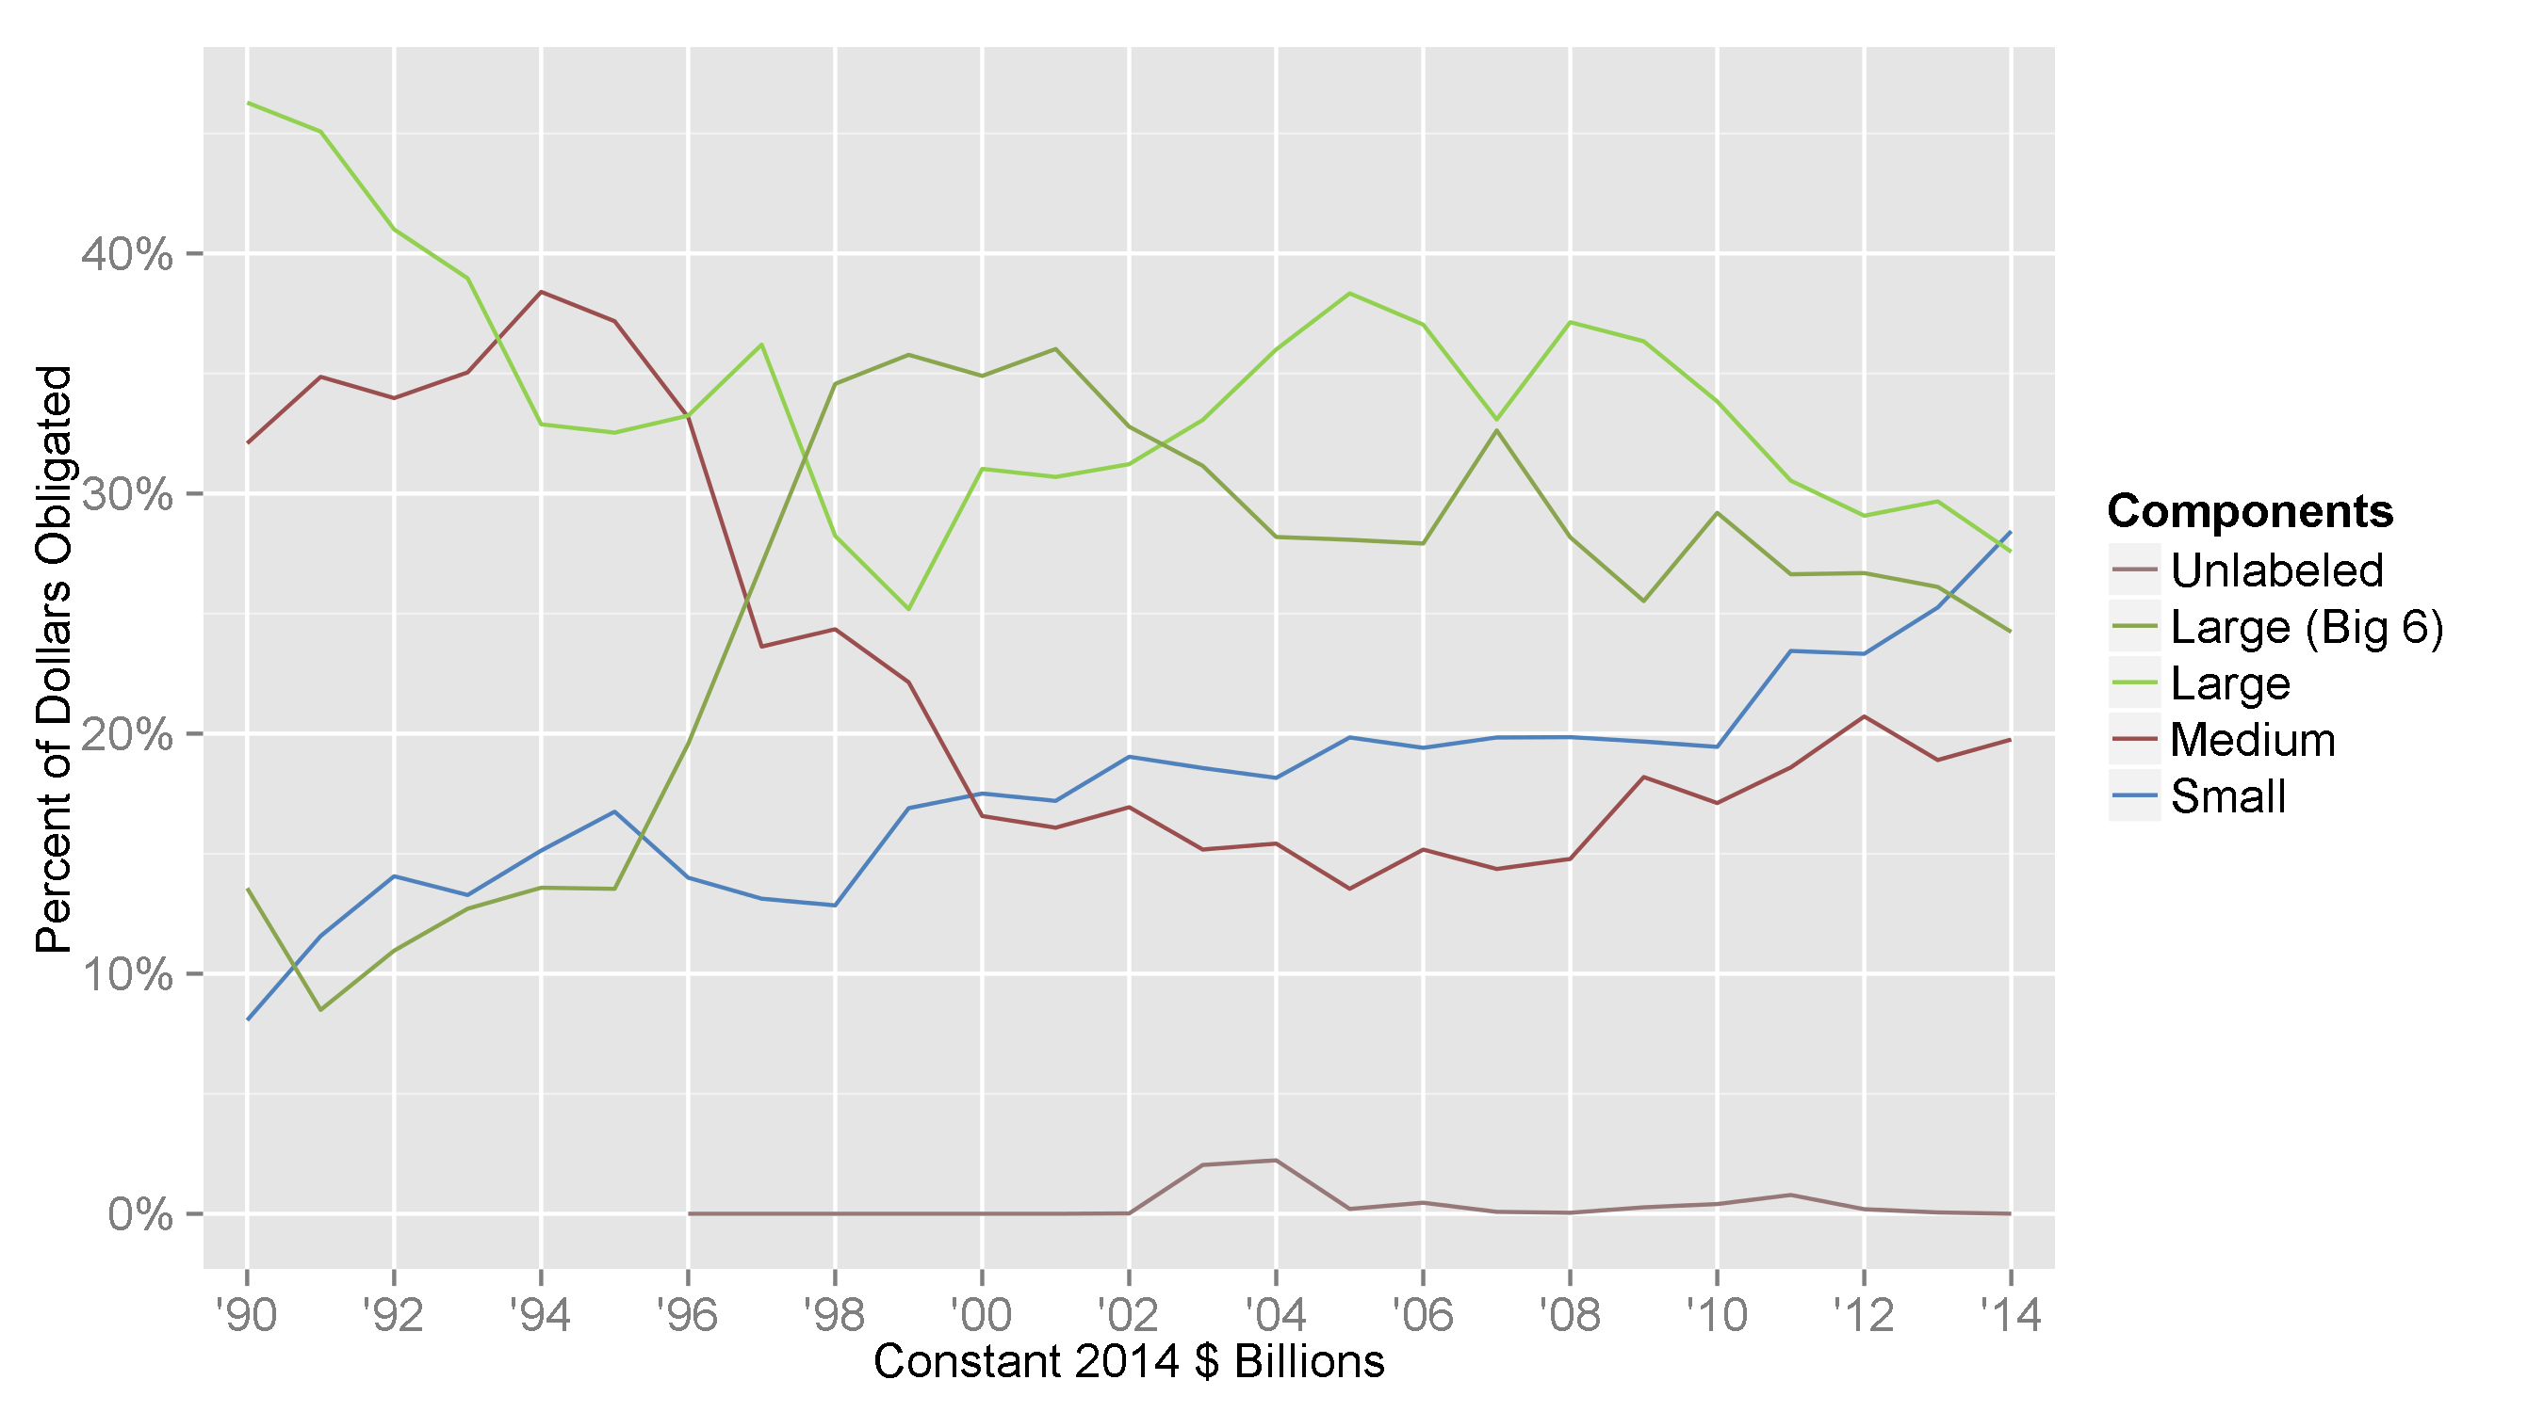
Defense Electronics & Communications Contract Obligations by Vendor Size, 1990-2014

Slide 18
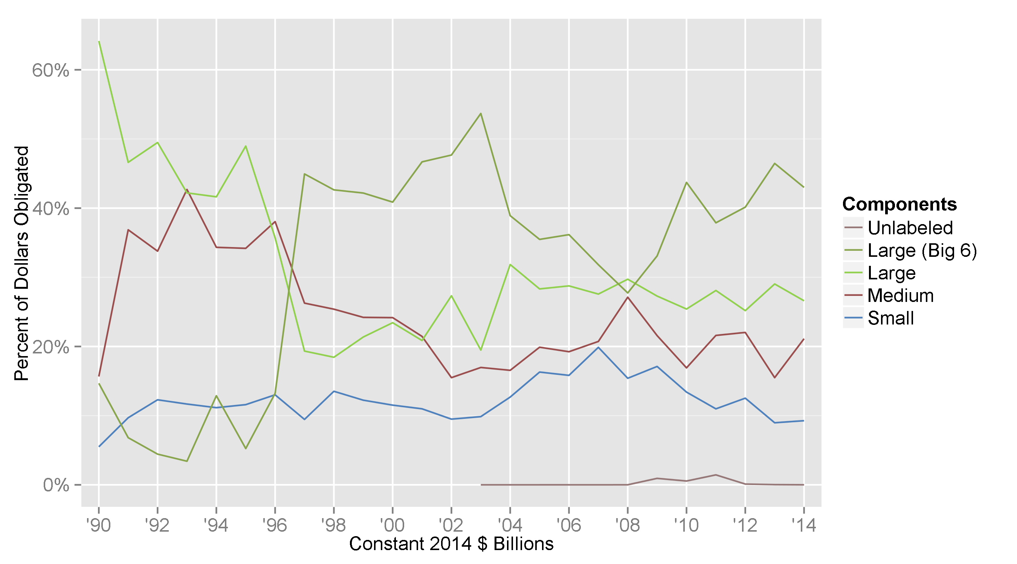
Defense Launchers & Munitions Contract Obligations by Vendor Size, 1990-2014

Slide 19
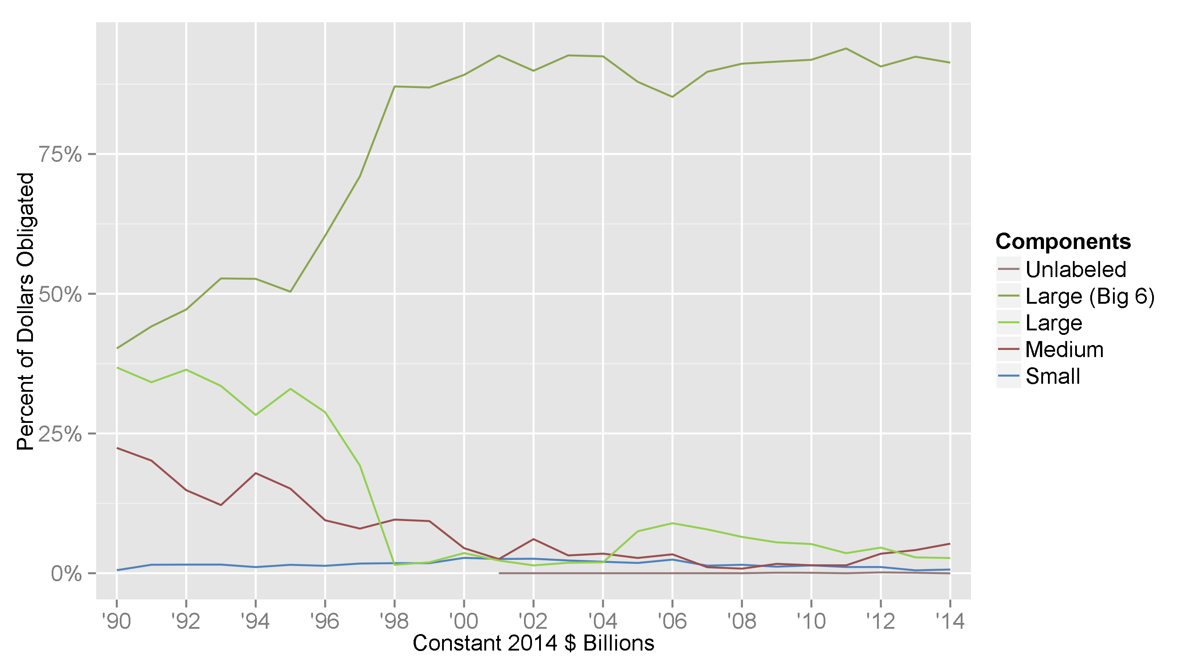
Defense Missiles & Space Contract Obligations by Vendor Size, 1990-2014

Slide 20
Conclusions
The current downturn has seen the relative preservation of contract obligations going to the Big 6 defense vendors, despite the divestment of Northrop Grumman’s large shipbuilding unit into Huntington Ingalls Industries.
Sequestration has had an enormous impact on defense products contracting, even in the context of the overall decline since the peak in 2008.
Cuts in obligations were not evenly distributed among the major DoD components and product categories in 2013 and 2014.
Want to go deeper? Cross-section data available at http://www.GitHub.com/CSISdefense/products

